Slide 1

Adaptive trials
I gratefully acknowledge the use of materials presented by James Wason in Wengen (CH) January 2025
Gerben ter Riet MD PhD
opensciencesupport@hva.nl
ORCID https://orcid.org/0000-0002-2231-7637

Slide 2
Trials come in many flavors
30 CONSORT extensions
Equivalence
Non-inferiority
Stepped wedge (cluster)
Factorial
Cross-over
Adaptive (flexible)
….multi-arm multi-stage (MAMS), …

Slide 3
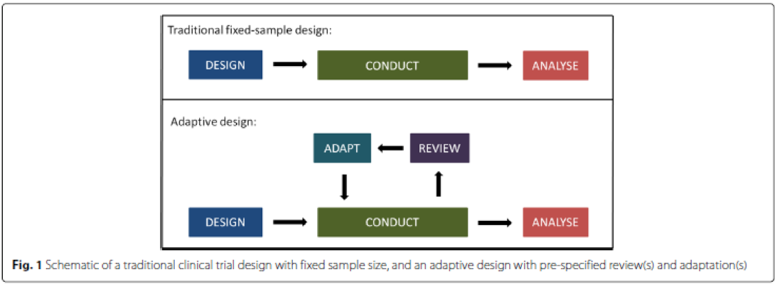
Basic overview of adaptive trial design
An adaptive trial allows for prospectively planned modifications to aspect(s) of the trial procedures based on accumulating data from participants, without undermining the trial’s validity.
… flexible in a planned, principled, and statistically controlled way.
Notes:
Similarity with qualitative research (change while ongoing), but protocol specifies many constraints beforehand
But all adaptations are pre-planned!

Slide 4
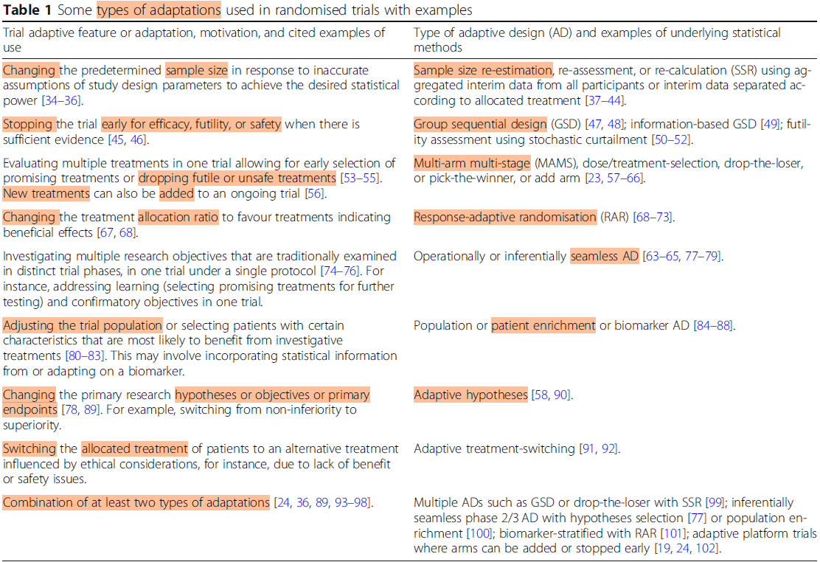
… flexible in a planned, principled, and statistically controlled way.
Notes:
https://trialsjournal.biomedcentral.com/articles/10.1186/s13063-020-04334-x
Note: various examples may happen in ordinary non-adaptive trials (not reaching the planned sample size, stopping due to SAEs, lack of funds, or unplanned data-peaking (p-hacking) or outside evidence (of harm or efficacy) that makes continuation unethical, using data from pilot study in the main analysis of the ensuing trial, (attampted) recruitment of more patients through advertisements in an ongoing trial), unplanned treatment arm switching). However, some of these examples are (seen as) poor practice. Others rely on information outside the trial, which is not what adaptive trials are about: pre-planned adaptations (while controlling type 1 error)

Slide 5
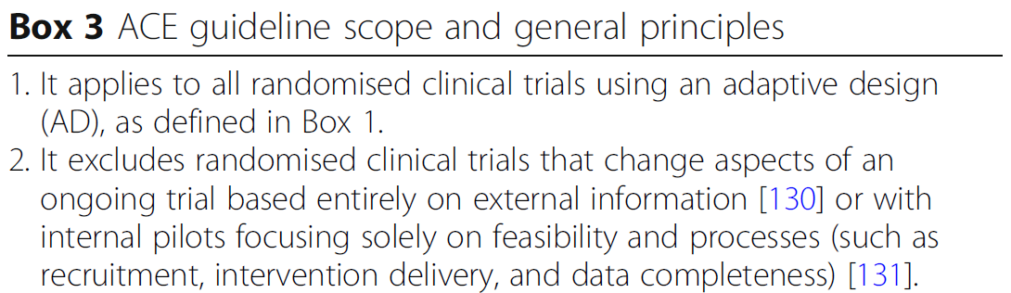
Adaptations not counting as Adaptive Designs

Slide 6
Group-sequential designs
Interim analysis
Stop for efficacy or stop for futility
Show slides 29 – 33 in Lecture 1 (Wengen 2025)

Slide 7
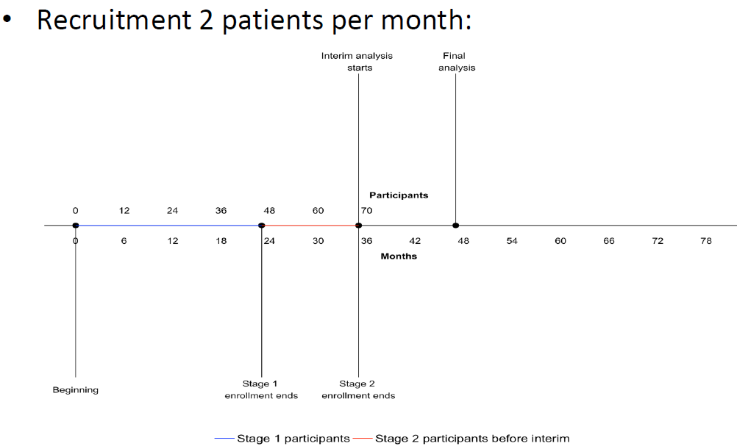
Endpoint info for interim analysis must be available in time. (Here: too late)
Target recruitment is 70 patients. Pre-planned interim analysis using information from first 46 patients to decide whether the treatment is showing sufficient promise
Endpoint information ready
46th

Slide 8
Sample size reassessment (SSR)
What if the standard deviation assumed is wrong?
What if the control-arm event rate assumed is wrong?
Risk of underpoweredness or recruiting longer than needed

Slide 9
Interim analysis
Data monitoring committee (DMC)
DAMOCLES protocol for DMCs (and steering committees)
Interim decisions (examples):
Change sample size (SSR)
Drop ineffective treatment(s) (MAMS)
Change randomization ratio (e.g., 20:20:20:20:20 → 30:30:20:15:5) (RAR)
Stop (for efficacy or futility) (GSD)
Notes:
https://pubmed.ncbi.nlm.nih.gov/15721478/
SSR=sample size re-estimation; MAMS=multi-arm multi-strategy; RAR=Response-adaptive randomization; GSD=group sequential design

Slide 10
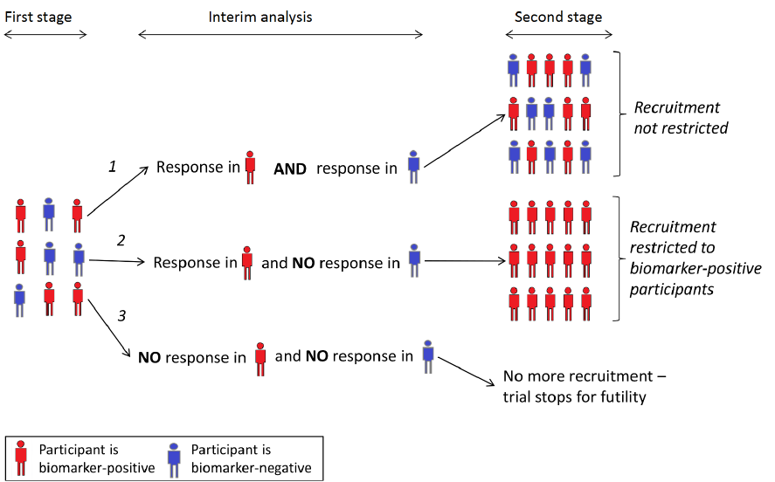
Adaptive Enrichment

Slide 11
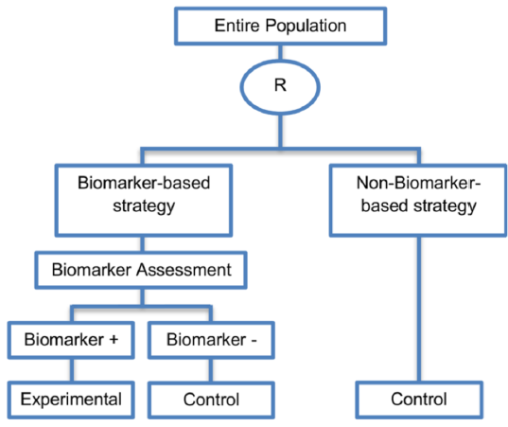
Test utility design

Slide 12
Basket, platform, and umbrella trials
Design | Groups | Treatments | Quick note
Standard RCT | 1 | Exp + control | Single cohort, 1 active arm compared with a control.
Basket trial | > 1 (different biomarker/phenotype) | Exp + common control | One experimental regimen is tested across several distinct sub‑populations.
Platform trial | 1 (single disease or target group) | > 1 + shared control | Multiple experimental arms can be added or dropped while all share one control arm.
Umbrella trial | > 1 (parallel sub‑studies based on clinical or functional subtype) | > 1 + individual controls per sub‑study | Each sub‑study has its own tailored intervention(s) and its own control, all under one master protocol.
Notes:
Basket trials are similar to pre-planned sub-group analyses within a single trial since the treatment contrasts are identical, unlike in umbrella trials where only the control treatment is identical. Both designs may benefit from Bayesian analysis.

Slide 13
Basket trial in nutrition research?
Protein‑Blend + Resistance Training Across Metabolic Phenotypes
P (Population): Adults 45‑70 y with overweight/obesity, stratified into 3 metabolic “baskets”: (a) insulin‑resistant, (b) dyslipidemic, and (c) sarcopenic‑predominant.
I (Intervention): Standardized 12‑week resistance‑training program plus a basket‑specific protein supplement: whey‑based for insulin‑resistant, plant‑based pea‑rice blend for dyslipidemia, and leucine‑enriched casein for sarcopenic participants.
C (Comparator): Same training program plus iso‑caloric maltodextrin placebo drink matched for taste and volume.
O (Outcome): Change in basket‑specific primary endpoint at week 12: (a) HOMA‑IR, (b) LDL‑particle size, (c) appendicular lean‑mass index.
Notes:
I asked https://lumo.proton.me/: “Using the PICO structure for trial interventions, give me three 4-line examples of a 1. a basket trial, 2. a platform trial and 3. an umbrella trial in the field of protein diet research and exercise (resistance training). The examples may be made up but should be realistic.”

Slide 14
Platform trial in nutrition research?
PRO‑FIT Platform: Adaptive Evaluation of Protein‑Timing Strategies With Resistance Exercise
P (Population): Community‑dwelling men and women 30‑55 y, recreationally active, free of chronic disease, enrolled in a 16‑week supervised resistance‑training regimen.
I (Intervention): Multiple concurrent “arms” testing distinct protein‑timing regimens: (A) pre‑exercise 30 g whey, (B) intra‑exercise 20 g hydrolysate, (C) post‑exercise 40 g casein, (D) control (no supplemental protein). New arms (e.g., intermittent fasting + protein) can be added during the trial.
C (Comparator): Shared control arm (no protein supplement) that continues throughout the platform; each active arm is compared against this common comparator using a shared statistical model.
O (Outcome): Primary: composite of absolute change in muscle cross‑sectional area (MRI) and maximal leg press strength at week 16.
Notes:
I asked https://lumo.proton.me/: “Using the PICO structure for trial interventions, give me three 4-line examples of a 1. a basket trial, 2. a platform trial and 3. an umbrella trial in the field of protein diet research and exercise (resistance training). The examples may be made up but should be realistic.”

Slide 15
Umbrella trial in nutrition research?
P (Population): Athletes and physically active adults (18‑40 y) recruited into three parallel sub‑studies based on training objective: (i) hypertrophy‑focused, (ii) strength‑focused, (iii) endurance‑strength hybrid.
I (Intervention): Within each sub‑study participants are randomized to one of three protein formulations matched to the goal: (i‑a) high‑leucine whey isolate, (i‑b) collagen‑peptide blend, (i‑c) placebo; (ii‑a) casein‑rich slow‑release, (ii‑b) creatine‑fortified whey, (ii‑c) placebo; (iii‑a) soy‑protein with β‑alanine, (iii‑b) mixed‑plant blend with electrolytes, (iii‑c) placebo. All receive the same 12‑week periodised resistance‑training protocol.
C (Comparator): Placebo protein drink (maltodextrin) within each sub‑study, providing identical calories and flavor without protein.
O (Outcome): Sub‑study‑specific primary endpoints measured at week 12: (i) percent increase in muscle fiber CSA (biopsy), (ii) 1‑RM squat improvement, (iii) time‑to‑exhaustion at 70 % 1‑RM after a standardized circuit; secondary outcomes include serum IGF‑1, nitrogen balance, and training adherence.
Notes:
I asked https://lumo.proton.me/: “Using the PICO structure for trial interventions, give me three 4-line examples of a 1. a basket trial, 2. a platform trial and 3. an umbrella trial in the field of protein diet research and exercise (resistance training). The examples may be made up but should be realistic.”

Slide 16
Suggestions
Find examples of adaptive trials in your field
Read up on methods
Read up on reporting (CONSORT ACE)
Consider the use of adaptive trial designs
Seek collaboration with skilled statistician(s) for valid simulations
As always, carefully weigh and consider design choices

Slide 17

Notes:
Download slides on https://www.researchequals.com/grietter

Slide 18
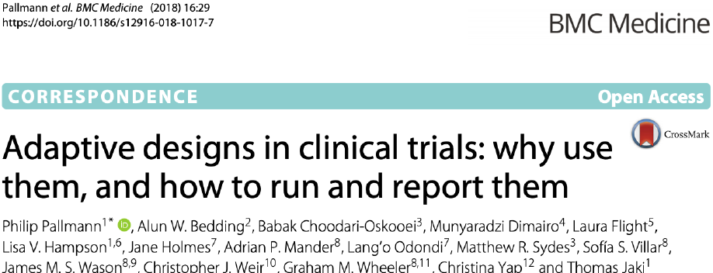

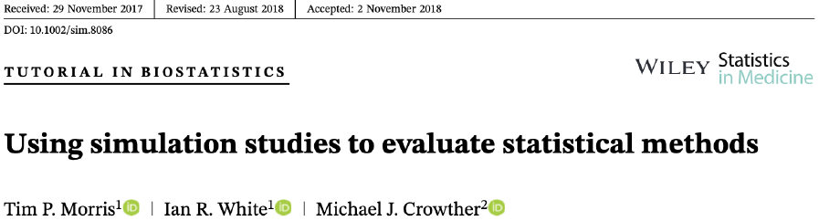
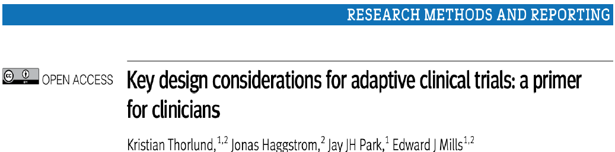
Role of simulation in adaptive trial design; refs for beginners

Slide 19
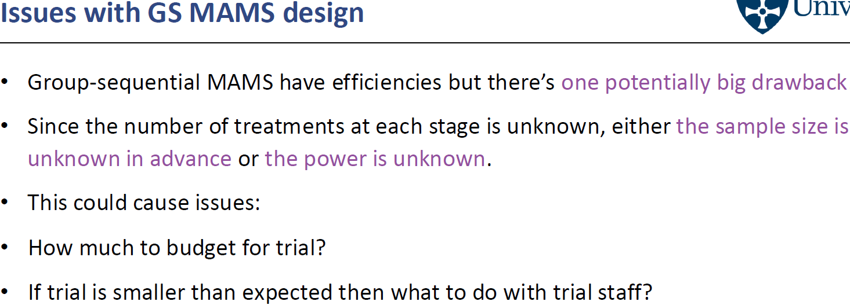
Group-sequential MAMS
Show slide 12- 14 in lecture 2 (Wengen 2025)

Slide 20
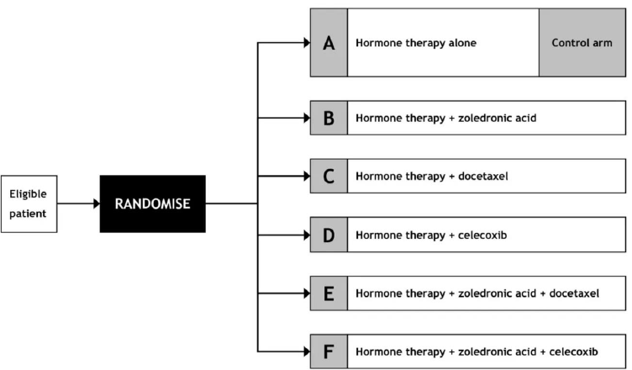
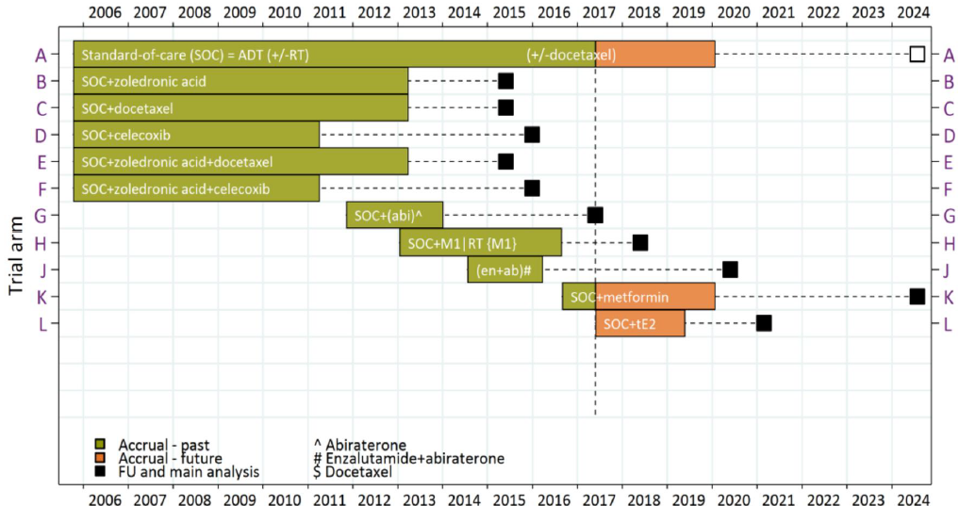
Platform trial (https://www.stampedetrial.org/ )

Slide 21
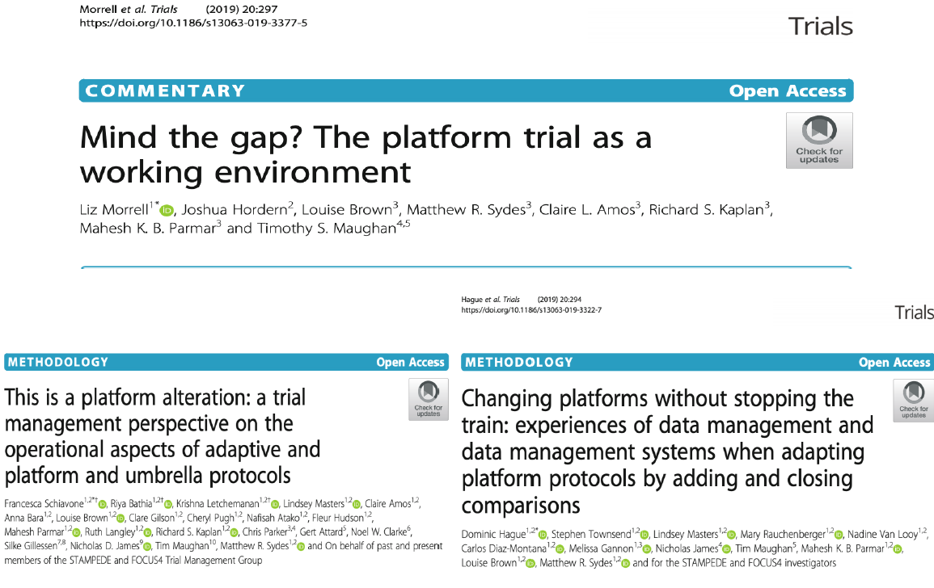
Platform trials - organization
Support from funders, ethics committees, research networks
Implications for trial and data management
Difficult to control type I error rate

